Slide 1
What is Bioconductor?
Lori Ann Shepherd Kern
Bioconductor Project Manager/Core Team
Lori.Shepherd@Roswellpark.org

Slide 2
Bioconductor is not a package; it’s a package repository
Bioconductor provides tools for the analysis, comprehension, and visualization of genetic and genomic data as an R package repository system. It is open source and open development, relying on community contributed R packages.
Website: https://bioconductor.org/
Support Site: https://support.bioconductor.org/
Contributors Resource: https://contributions.bioconductor.org/

Slide 3
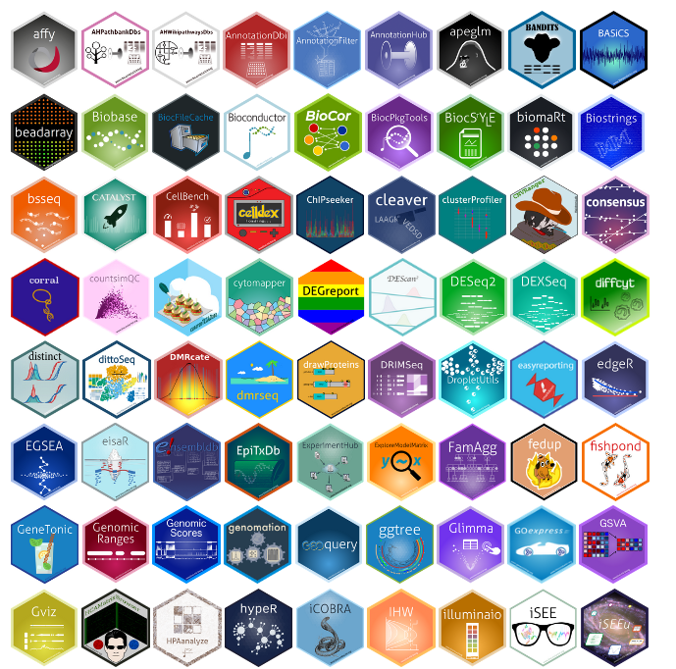
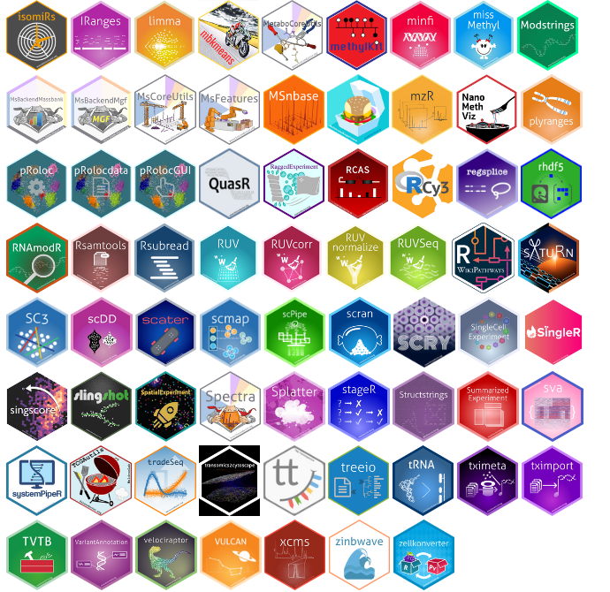
Just some of the many Bioconductor available packages!!

Slide 4
Bioconductor is an organization
Advisory Boards Help Shape the direction of the project and ensure technological relevance:
Bioconductor Foundation / European Bioconductor Society
501(c)(3) organization , handles money regarding conference organization, donation, and sponsorship
Scientific Advisory Board (SAB)
Provides external guidance and oversight of scientific direction of the project. Invitation Only Board.
Technical Advisory Board (TAB)
Advises on Project and Package level infrastructure for the project. Open Call to anyone; elections held annual in Spring
Community Advisory Board (CAB)
Dedicated to developing, enhancing, and diversifying the Bioconductor community. Open Call to anyone; elections held annual in Spring
Core Team
Developers that maintain, enhance, and develop core packages and project level infrastructure
International Bioconductor Community !!
Note:
Bioconductor Foundation will likely dissolve as we explore a collaboration with NumFocus.

Slide 5


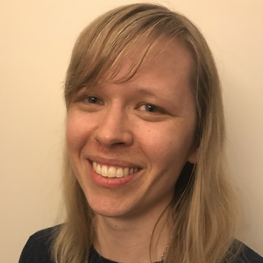
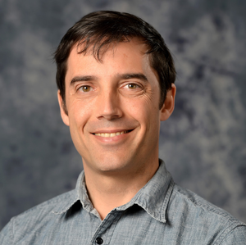
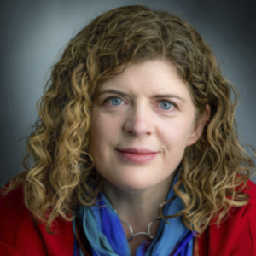
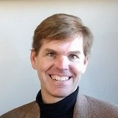
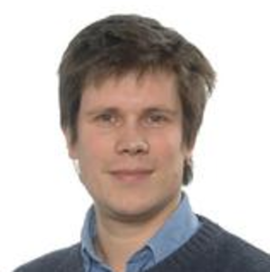
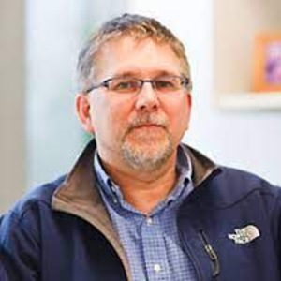
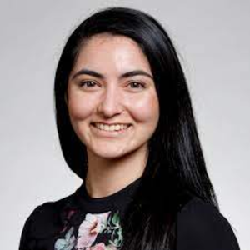
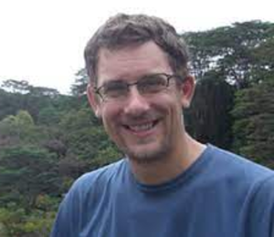
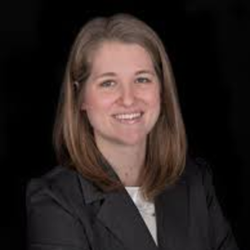
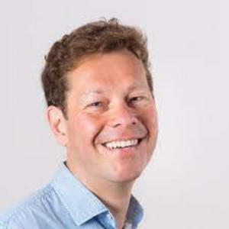


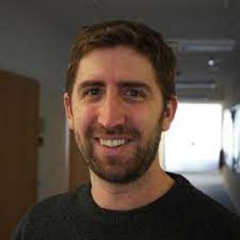
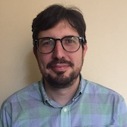
Technical Advisory Board
https://bioconductor.org/about/technical-advisory-board/
Vince Carey
Charlotte Soneson
Levi Waldron
Aedin Culhane
Sean Davis
Laurent Gatto
Robert Gentleman
Shila Ghazanfar
Kasper Daniel Hansen
Stephanie Hicks
Wolfgang Huber
Rafael Irizarry
Lori (Shepherd) Kern
Michael Love
Davide Risso

Slide 6
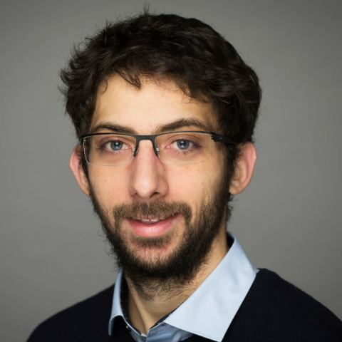
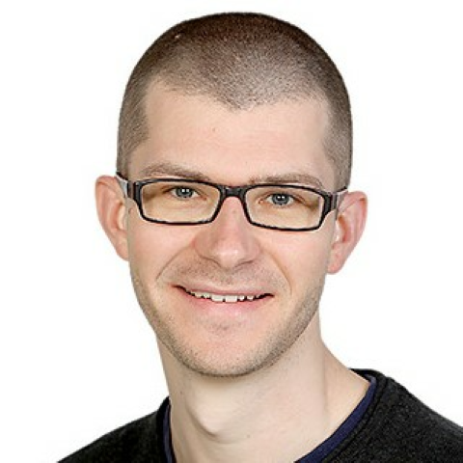
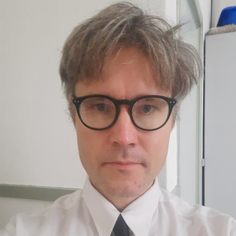
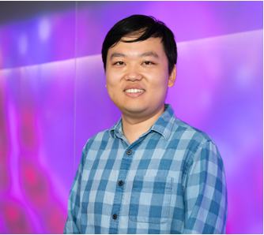
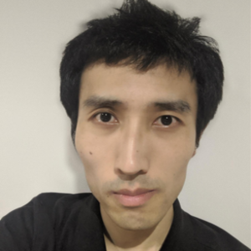
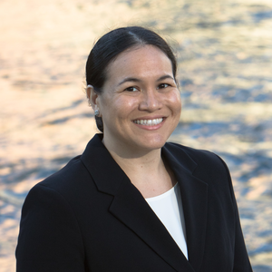



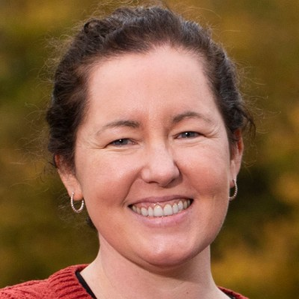

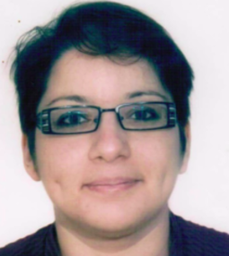
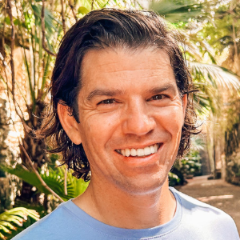
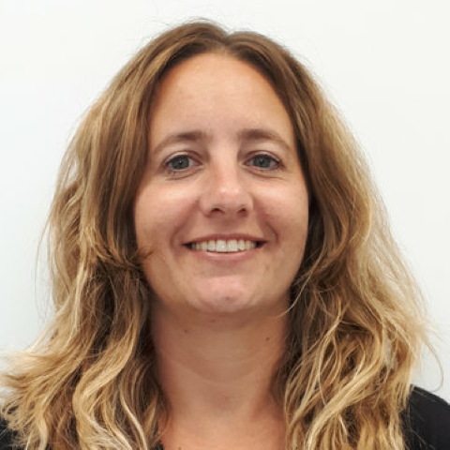
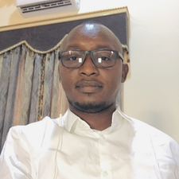

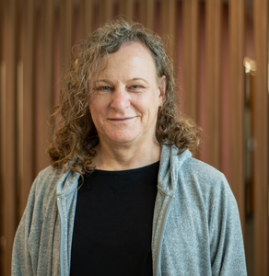
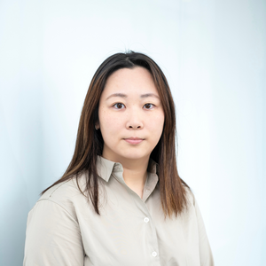
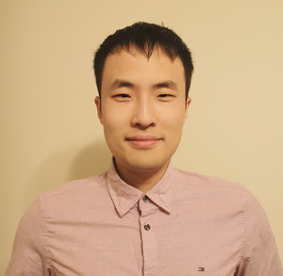


Kevin Rue-Albrecht
Mike Smith
Leo Lahti
Luyi Tian
Kozo Nishida
Nicole Ortogero
Daniela Cassol
Aedin Culhane
Johannes Rainer
Maria Doyle
Lori (Shepherd) Kern
https://bioconductor.org/about/community-advisory-board/
Hedia Tnani
Enis Afgan
Estefania Mancini
Umar Ahmad
Xueyi Dong
Stevie Pederson
Mengbo Li
Jiefei Wang
Jordana Muqanguzi
Janani Ravi

Slide 7
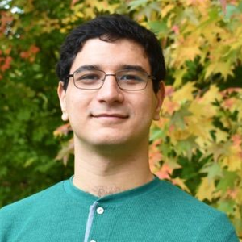
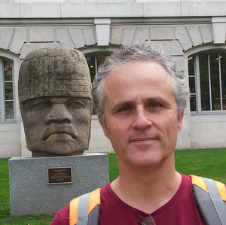
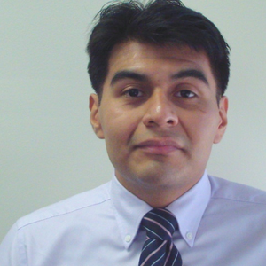
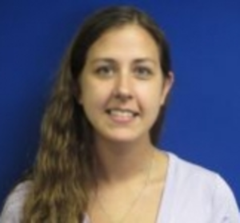
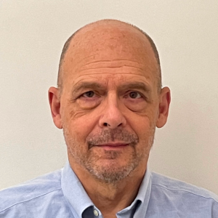
Core Team
https://bioconductor.org/about/core-team/
Lori (Shepherd) Kern
Vince Carey
Alexandru Mahmoud
Herve Pages
Marcel Ramos
Robert Shear
Jennifer Wokaty
Kayla Interdonato

Slide 8


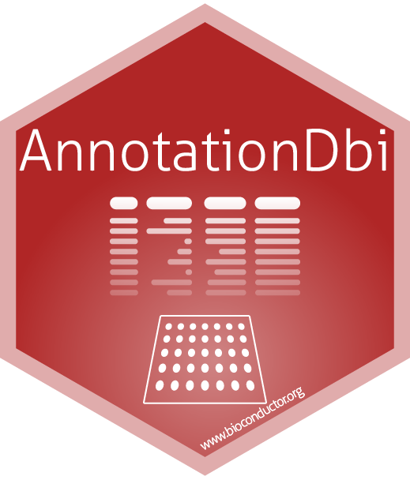


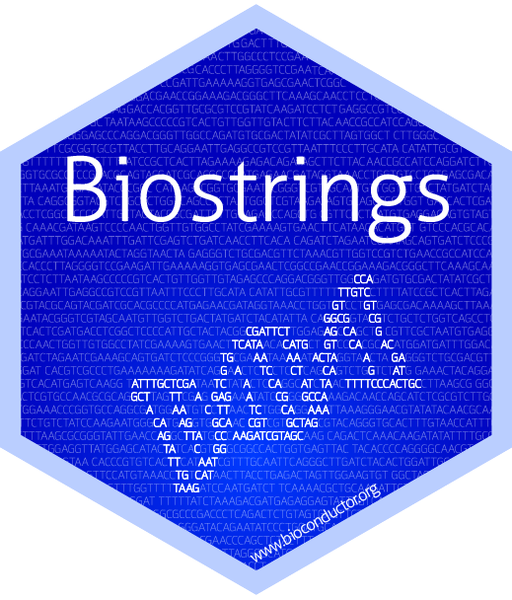

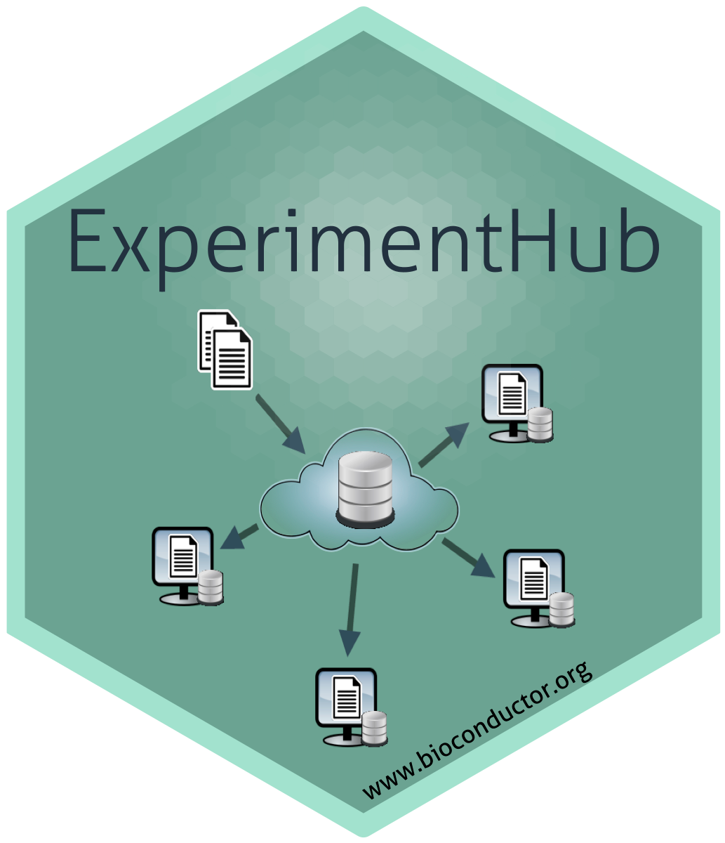

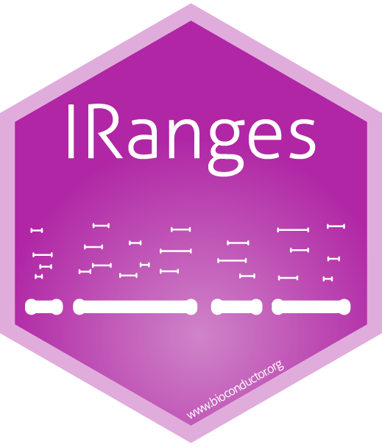
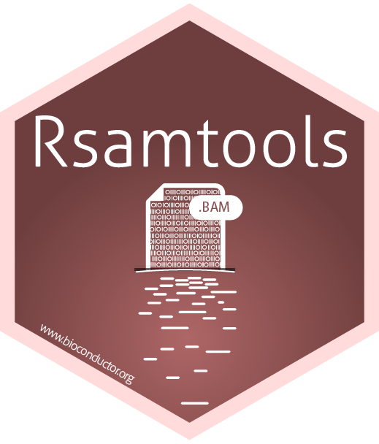
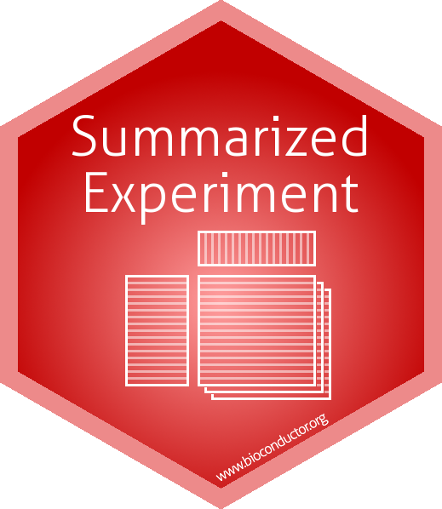
Core Team: It’s Not Just the Packages
Just a few of many Bioconductor Core Maintained Packages

Slide 9
Core Team: Infrastructure Development and Maintenance
Develop and maintain Bioconductor infrastructure packages
Bioconductor.org maintenance
Support.bioconductor.org maintenance
Answering questions on all outlets
Bioconductor Build System (BBS) for daily builds and reporting
Docker Image generation
Binary Package generation (AnVIL/Docker)
New Package Submission (SPB) process and review
AWS infrastructure
Azure infrastructure
OSN infrastructure
Jetstream2 processes
Maintaining the git ecosystem
Package download stats
BiocManager maintenance
Bioconductor ExperimentHub and AnnotationHub integration
Outreachy projects
And more …. So if we don’t get to your question right away please be kind!

Slide 10
Bioconductor is a community!
Bioconductor provides resources and infrastructure to link experienced package maintainers, developers and users with the inexperience to foster a collaborative and welcoming community of R Bioconductor users.
Support Site: https://support.bioconductor.org/
Community Slack channel: community-bioc.slack.com
Conferences / Workshops / Events: https://bioconductor.org/help/events/
Mentoring Program: community-bioc.slack.com #developers-mentorship channel

Slide 11
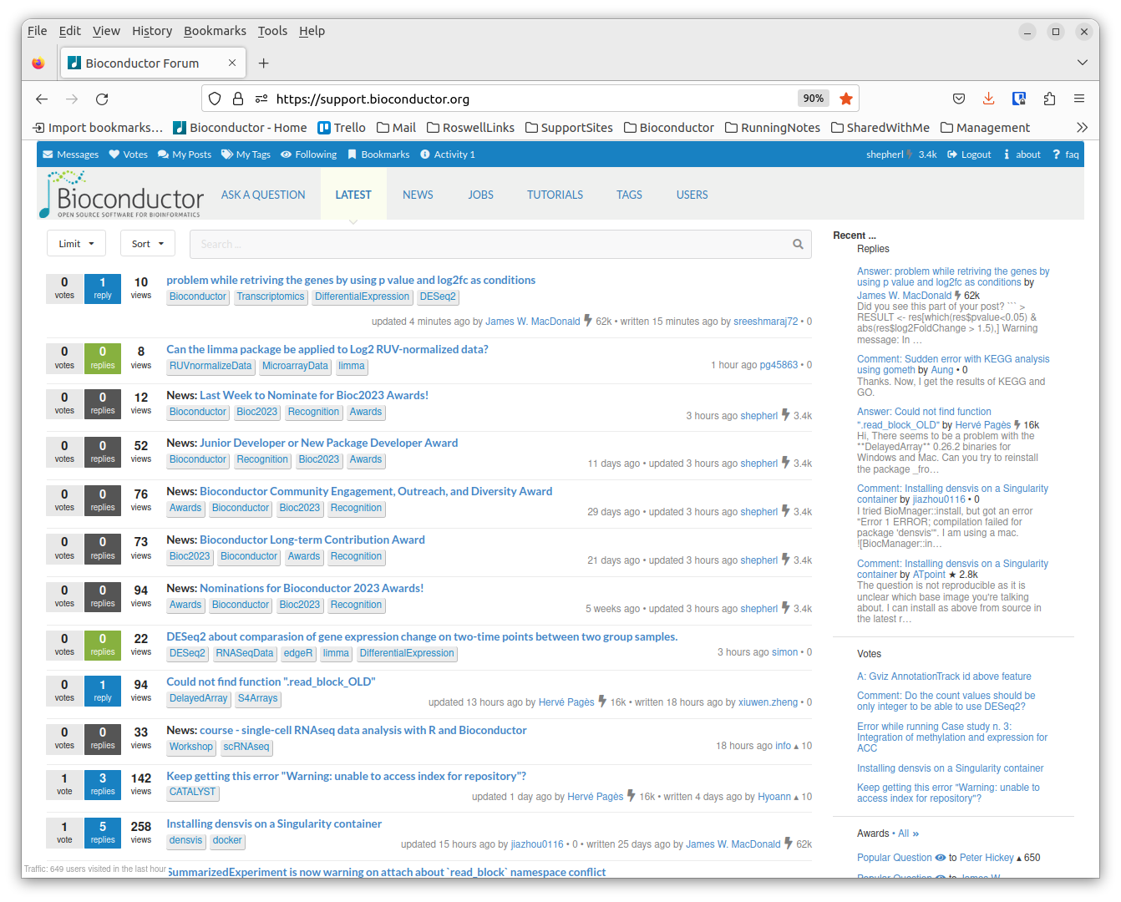
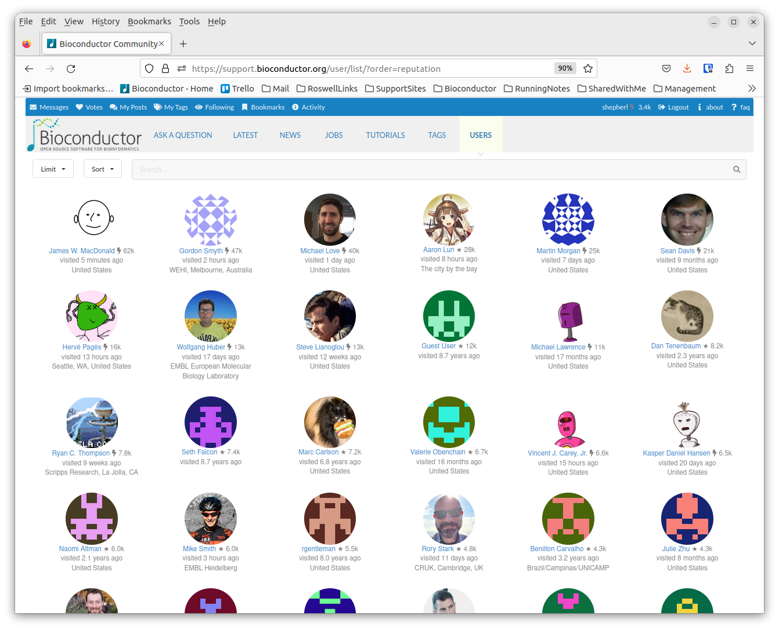
Support Site: https://support.bioconductor.org/
Ask questions about packages or data analysis
Thousands of Bioconductor users and maintainers are members

Slide 12
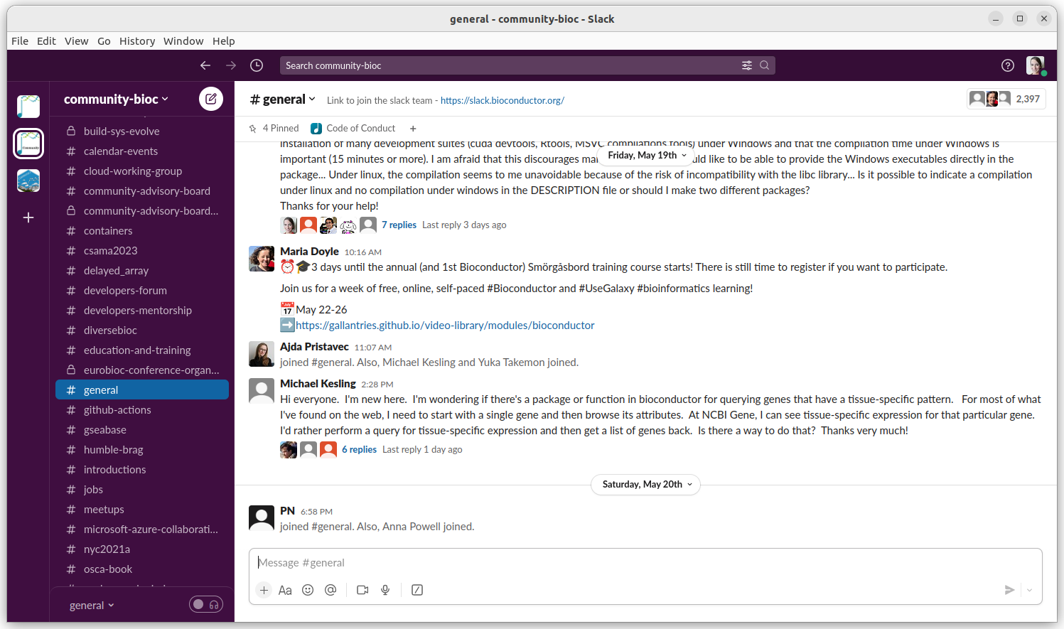
Community Slack channel: community-bioc.slack.com

Slide 13
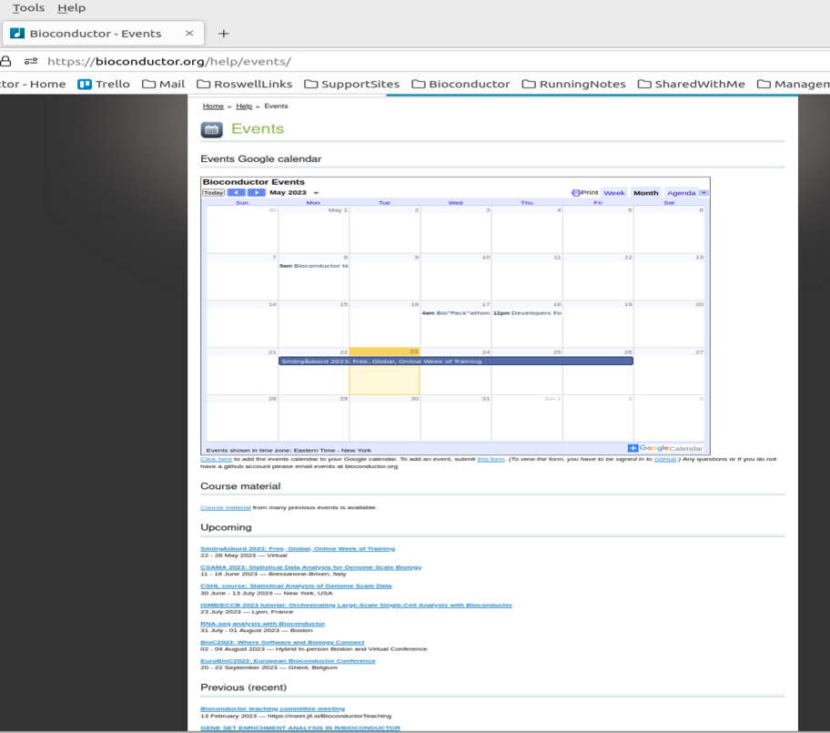
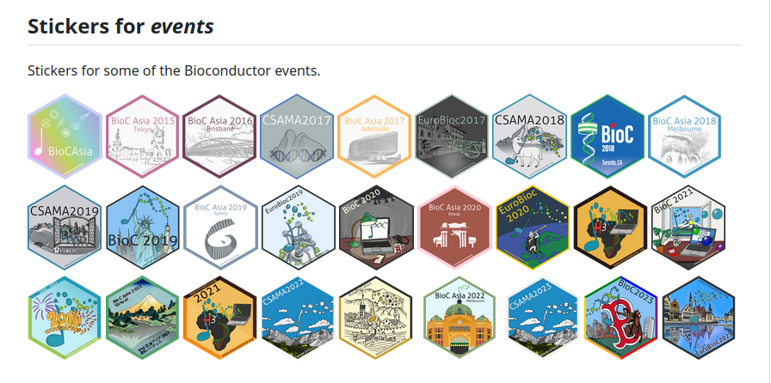
Bioconductor Conferences / Workshops / Events

Slide 14
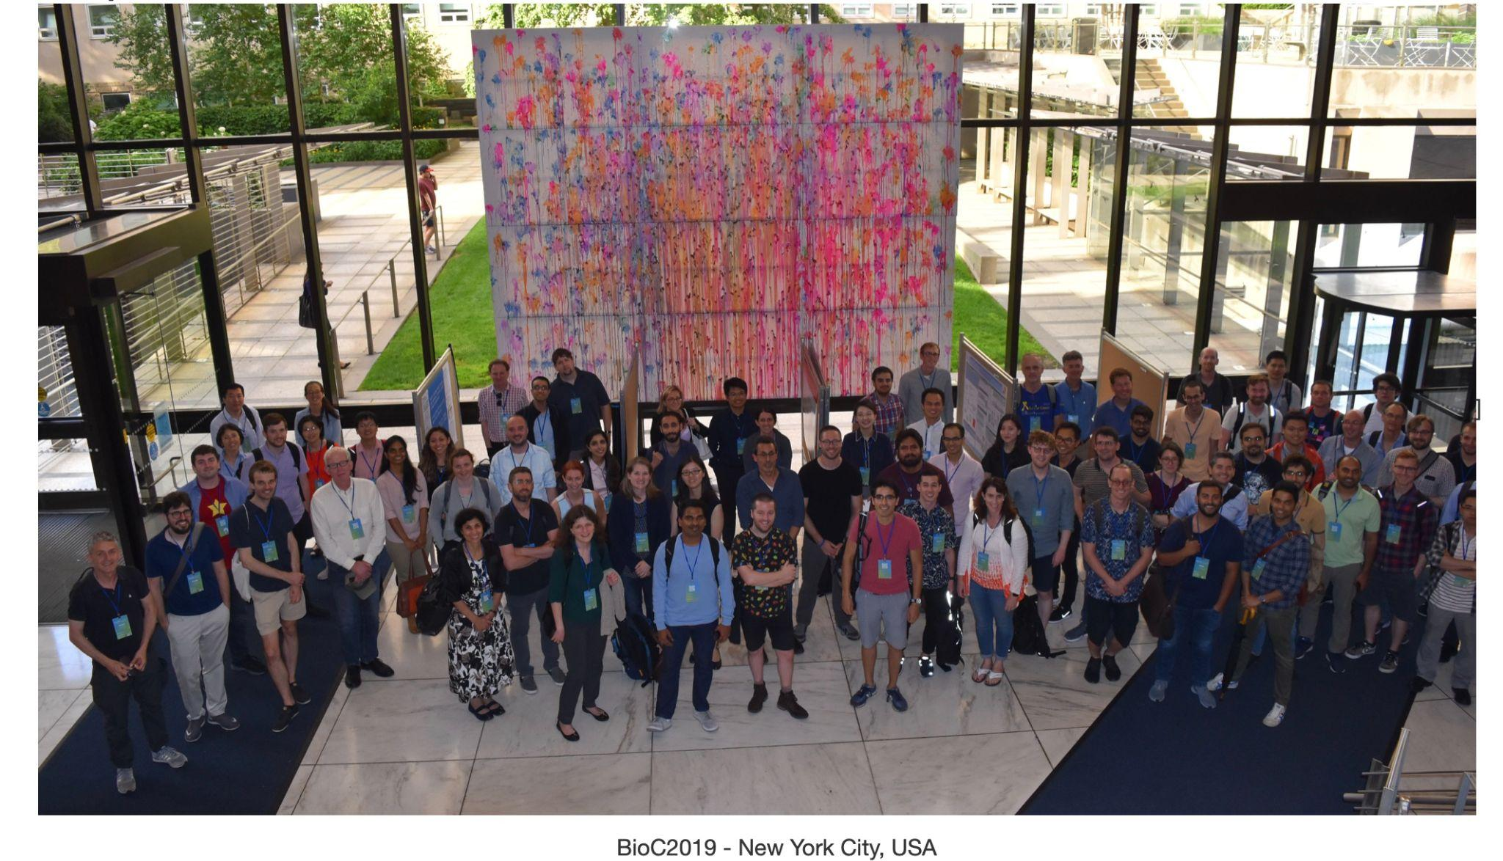
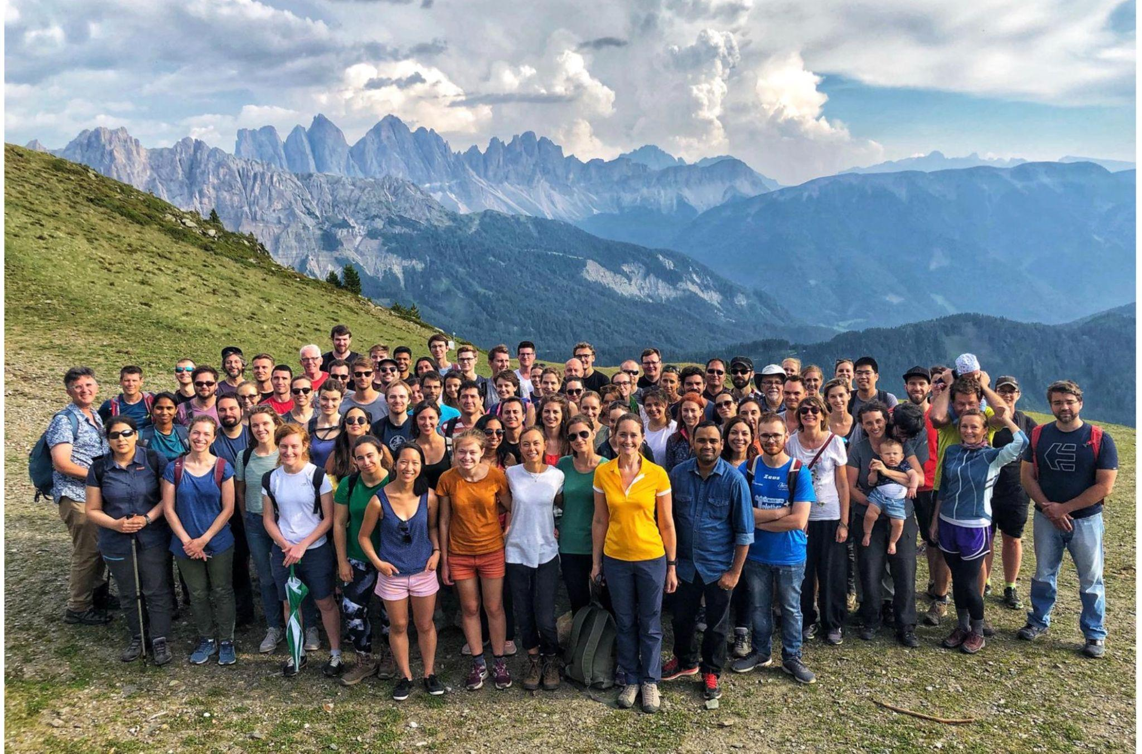
Brixen, Italy 2019

Slide 15
Developing Packages
While the Core Team maintains many ‘core infrastructure packages’, Bioconductor is largely community contributed.
Anyone can contribute a Bioconductor package.
Bioconductor has certain, specific package requirements that must be met and every package undergoes a review process. Once accepted, a package is added to the daily builder and available through BiocManager.

Slide 16
Just some of the many Bioconductor available packages!!

Slide 17
Working Groups and Committees
https://workinggroups.bioconductor.org/
Code of Conduct
Conference Planning
Cloud Methods
Developers Training
Education
Mass Spectrometry for Proteomics and Metabolomics
Multilingual
Package Review
Industry
Website
Social Media
Package Failure Notifications
Your new working group…..?

Slide 18
Other Social Media
Bioconductor has other social media outlets to connect the community!
Community Slack channel: community-bioc.slack.com
Twitter: https://twitter.com/Bioconductor
Mastodon: https://genomic.social/@bioconductor
LinkedIn: https://www.linkedin.com/company/bioconductor
Facebook: https://www.facebook.com/bioconductor (Rarely Used except for announcements)

Slide 19
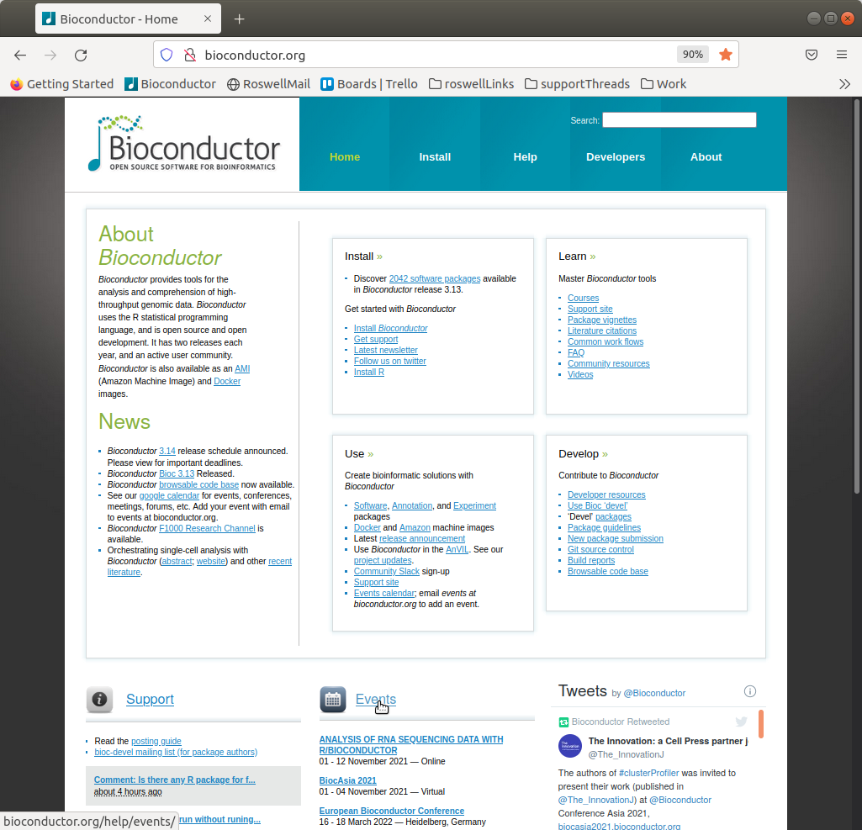
Website: https://bioconductor.org
Note:
The Bioconductor website is getting a new look!
We are looking for feedback from all types of users (beginner to advanced). If you are willing to be involved please let me know!!

Slide 20
Bioconductor Basics
How do I get started?

Slide 21
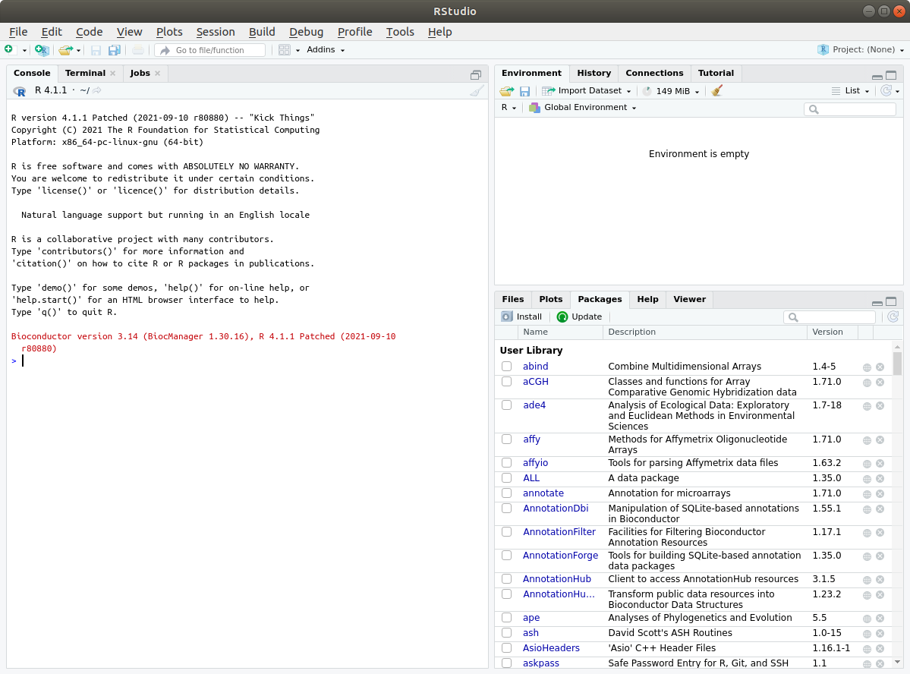
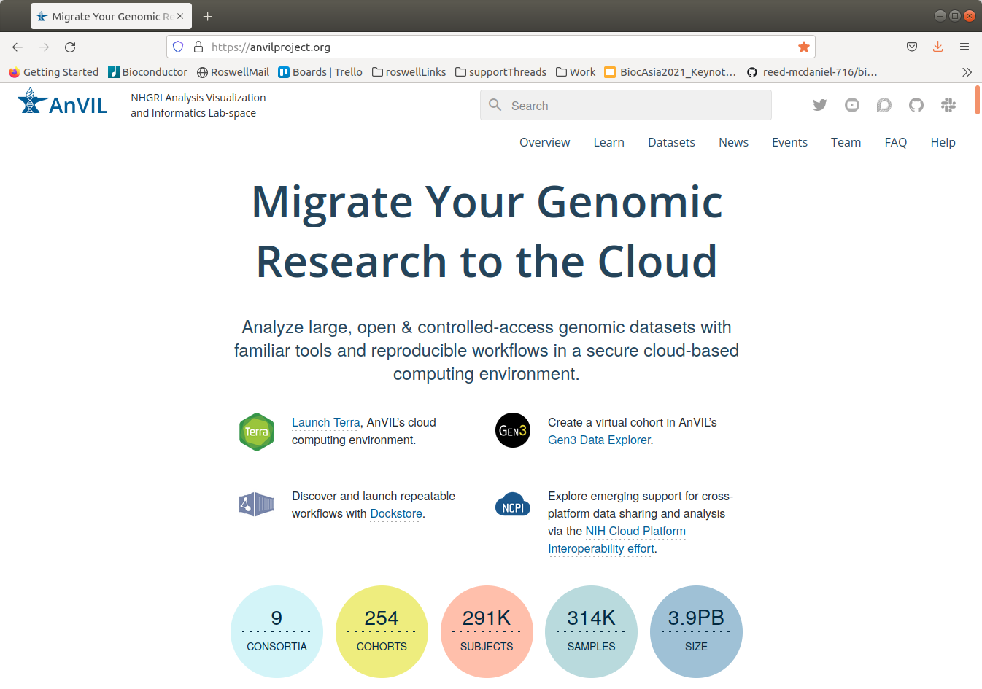
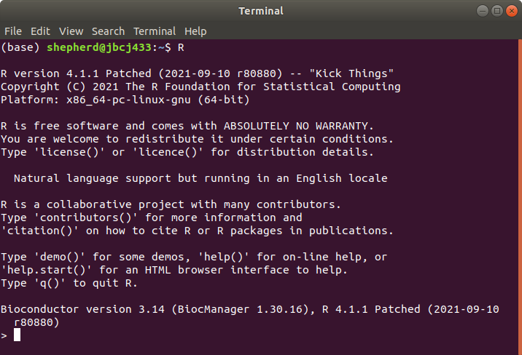

How does a user interact with Bioconductor?
AnVIL
R and Rstudio
Docker

Slide 22
Installing Bioconductor Packages: BiocManager
Bioconductor provides a function for installing packages from the Bioconductor repository and CRAN repository through the BiocManager package on CRAN
To install any Bioconductor package (or CRAN package) in R terminal or Rstudio:
# download and install BiocManager
> install.packages("BiocManager")
# usage
> library(BiocManager)
> install( <name of package[s]> )
# list all CRAN/Biocondutor packages available or search for name
> BiocManager::available() / BiocManager::available(“Genomic”)

Slide 23
Bioconductor Package: AnVIL
AnVIL (NHGRI Analysis Visualization and Informatics Lab-space)
Analyze large, open & controlled-access genomic datasets with familiar tools and reproducible workflows in a secure cloud-based computing environment.
https://anvilproject.org/
AnVIL users can perform data analysis with Bioconductor in Jupyter Notebooks or Rstudio.
The Bioconductor AnVIL package provides an AnVIL::install() to download Bioconductor package binaries.

Slide 24
Bioconductor Packages: Docker
https://bioconductor.org/help/docker/
Release and devel docker containers available
bioconductor/bioconductor_docker:devel
bioconductor/bioconductor_docker:RELEASE_X_Y
Install docker
Pull the desired bioconductor docker version
Run
Rstudio Server
command line (directly into R or as a bash shell)
Packages available as binary package install using BiocManager::install
Ability to modify base image as needed
Available on Singularity
Available on Microsoft Container Registry and Azure

Slide 25
Finding Bioconductor Packages

Slide 26

Bioconductor Home Page

Slide 28

Bioconductor biocViews Page

Slide 29
Books coming soon!

Slide 30
Search for biocViews Terms
Search for package name

Slide 32

Bioconductor Package
Landing Page

Slide 33


All Bioconductor packages use git for source control
Starting from new package submission and review, a package is moved into the Bioconductor git ecosystem. All changes must be pushed to git.bioconductor.org to propagate to users.

Slide 34
Nightly Builds from git.bioconductor.org
Packages contributed to Bioconductor have a repository on git.bioconductor.org that should be updated to propagate changes to Bioconductor end users
Actions performs:
Git clone
R CMD INSTALL
R CMD BUILD
R CMD CHECK
If a package builds and has a valid version bump to indicate a new package version, the package is propagated and available through BiocManager::install()

Slide 36


Slide 37


Slide 38


Slide 39

Timestamp to know what day it was generated
Indicates package version, git commit and commit date that the builders used
Click on any stage for more information

Slide 40
Bioconductor Concepts
Bioconductor version is closely associated with an R version
Bioconductor has a release twice a year.
Bioconductor has a release and devel branch of packages
Versions of packages have significance

Slide 41
Why is there a release and a devel branch of Bioconductor?
Apr May June July Aug Sept Oct Nov Dec Jan Feb Mar
Spring Release
Current Stable Release of R (R-patched) on CRAN used for both Bioconductor Release and Bioconductor devel branches
Fall Release
Current Stable Release of R (R-patched) on CRAN used for Bioconductor release branch
R-devel used for Bioconductor devel branches

Slide 42
Why is there a release and a devel branch of Bioconductor?
Bioconductor has the concept of a Release and a Devel version of every package.
Release is the stable, user centric branch. Changes should only be minimal to fix known issues/bugs
Devel is for new features, enhancements, and developments
Adapt to changes in base R before an R official release
http://contributions.bioconductor.org/troubleshooting-build-report.html
Adapt to packages enhancement and changes based on package Interoperability. Bioconductor packages can be closely dependent on each other.
Bioconductor has two releases a year (Spring/Fall).
Spring - closely tied to the R release (normally scheduled one week after R release)
Fall - Bioconductor devel switches to using R-devel in preparation for spring R release

Slide 43
Versions of packages
Pre-release < 0.99.0
No longer permitted. Only on local, non submitted Bioconductor packages.
Initial submission into Bioconductor 0.99.0
Few exceptions made for x.99.0 on submission for very specific cases (i.e moving from CRAN to Bioconductor)
On first Bioconductor release a package is generally 1.0.0
Bioconductor bumps versions at release automatically. Package version x.y.z
Y = even = release
Y = odd = devel
BiocManager can validate your installation and package versions with
BiocManager::valid()
BiocManager::install()

Slide 44
Other Bioconductor Concepts
interop/endomorphism
Interoperability
How: By reusing common data structures/data classes and existing functions (especially load/read)
Why: Users can make workflows easily without worrying about the format of their data
Endomorphism
We encourage developers to practice this when implementing functions so users know what to expect as output “you get what you give”
Not always appropriate or implemented but encouraged

Slide 45
Common Classes and Methods
https://contributions.bioconductor.org/important-bioconductor-package-development-features.html#reusebioc

Slide 46
Common Bioconductor Classes and Methods: Importing Data
GTF, GFF, BED, BigWig, etc., – rtracklayer ::import()
VCF – VariantAnnotation ::readVcf()
SAM / BAM – Rsamtools ::scanBam(), GenomicAlignments ::readGAlignment*()
FASTA – Biostrings ::readDNAStringSet()
FASTQ – ShortRead ::readFastq()
MS data (XML-based and mgf formats) – Spectra ::Spectra(), Spectra ::Spectra(source = MsBackendMgf::MsBackendMgf())

Slide 47
Common Bioconductor Classes and Methods: Classes
Rectangular feature x sample data – SummarizedExperiment ::SummarizedExperiment() (RNAseq count matrix, microarray, …)
Genomic coordinates – GenomicRanges ::GRanges() (1-based, closed interval)
Genomic coordinates from multiple samples – GenomicRanges ::GRangesList()
Ragged genomic coordinates – RaggedExperiment ::RaggedExperiment()
DNA / RNA / AA sequences – Biostrings ::*StringSet()
Gene sets – BiocSet ::BiocSet(), GSEABase ::GeneSet(), GSEABase ::GeneSetCollection()
Multi-omics data – MultiAssayExperiment ::MultiAssayExperiment()
Single cell data – SingleCellExperiment ::SingleCellExperiment()
Mass spec data – Spectra ::Spectra()
File formats – BiocIO ::`BiocFile-class`

Slide 48
Questions and Comments
I welcome any comments or questions anyone had on the presentation.
Email
lori.shepherd@roswellpark.org
Community-bioc.slack.com
Display name: @lshepherd

